Slide 1


Web Scraping Project
Group List:
Ricardo Wu
Ka Ho LI
Anmol Thadani
Notes:
Have you ever thought about that opinions can be simulated by mathematical models? You may find it appalling but they have been applied in many environments

Slide 2
How we do the do the whole project?
How be data used to analyze?
Limitations
Methodology
Data processing
Conclusion
Background
Web scrapping
Analysis
What are we doing?
Where do the data come from?
What have we found out?

Slide 3
Background
What are we doing?

Slide 4
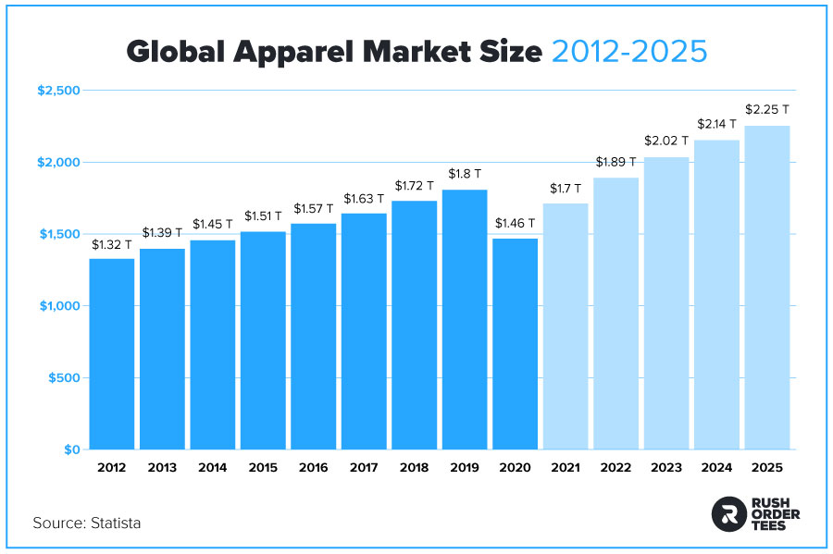
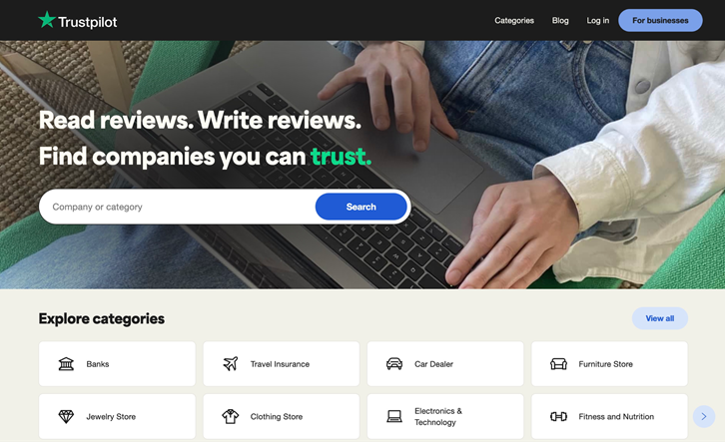
Background
Retail is always a significant part in a local economy, apparel market can be regarded as the most symbolic representative
Situation: We are employees of a US clothing retail group and are trying to randomly collect reviews from 20 retailers with highest rating and 20 with lowest rating from an integrated platform
https://www.trustpilot.com/

Slide 5
Aims of the Project
1. To have a better understanding of customer feedback on the shopping experiences.
2. To improve customer services through insights from web scraping, data mining on text analysis and Statistics through below analysis
find out best rated 20 & worst rated 20 Clothing stores
find correlation between reviews & trust score
do sentiment analysis through the comments
find out what are the most mentioned keywords in general
what customers concern most?

Slide 6
Methodology
How do we collect the data?

Slide 7
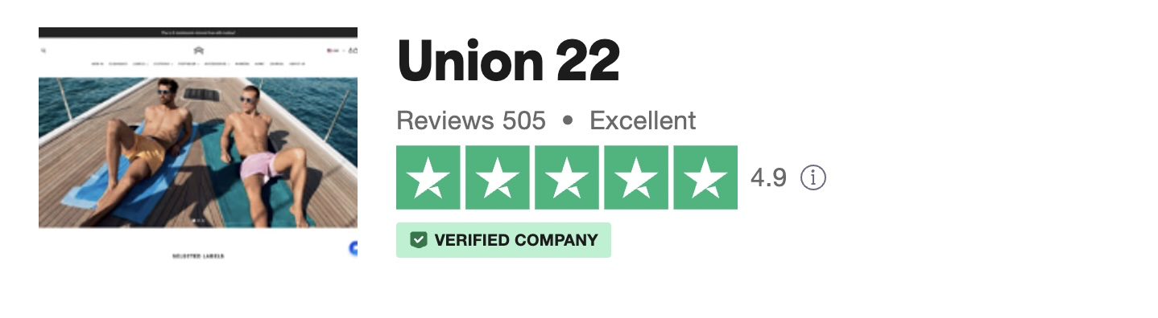

Methodology - Data Preprocessing
We scrape the data through BeautifulSoup
By Sampling, we only scrape the best 20 and worst 20 rated companies and only if they are verified
We classify the keywords into 3 groups based on their nature

Slide 8
Methodology - Analysis
The scrapped data is plain text and cannot conduct any research on it. The first step is data mining to quantify the data. TF-IDF scoring algorithm is considered too complicated; creating Chorus is technically impossible now. Afinn scoring algorithm is taken for simplicity
Afinn is the simplest, yet most popular lexicon used for sentiment analysis developed by Finn Årup Nielsen. It contains 3300+ words with a polarity score associated with each word. In python, there is an in-built function for this lexicon.
Afinn scoring algorithm acts similar with TD-IDF algorithm but has sentiment words preloaded, for Afinn score > 0, the sentence can be treated as positive comments, and vice versa. At the end, as we need to take total length into consideration for fair comparison, the Afinn scores were standardized through being divided by the sentence length.

Slide 9
Data processing
How are data used to analyze?

Slide 10
Data Processing
The data collected is stored in 4 separated CSV files, named cus_good20, cus_bad20, best_comments and worst_comments
cus_good20 and cus_bad20 stored best 20 and worst 20 rated retailers' information
best_comments and worst_comments stored reviews from sampled best 20 and worst 20 rated retailers
Next, the data in cus_good20 and cus_bad20 are used to count both types of retailers' reviews to compare the average reviews per retailer
The data in best_comments and worst_comments then are used to conduct sentiment analysis using Afinn scoring algorithm
Libraries used in data processing are: Afinn, Re, Numpy, Matplotlib

Slide 11
Analysis
What have we found out?

Slide 12
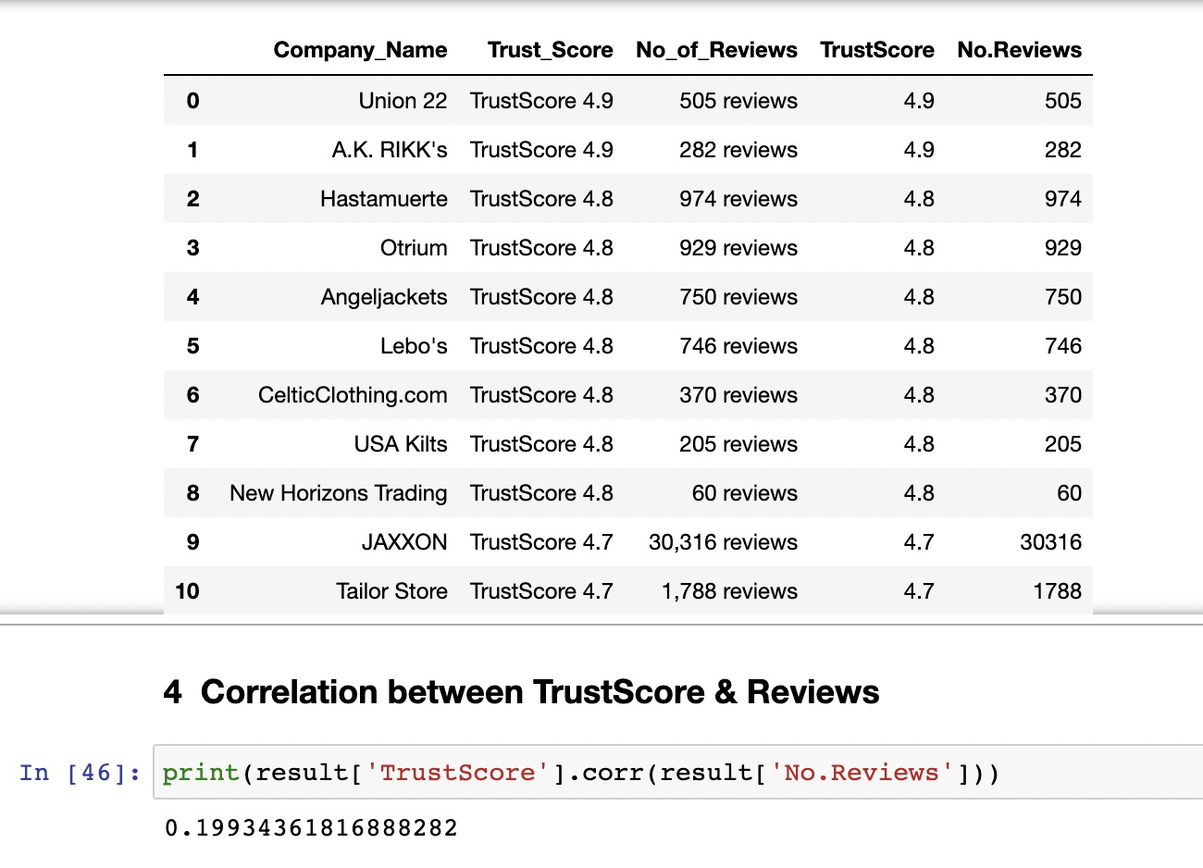
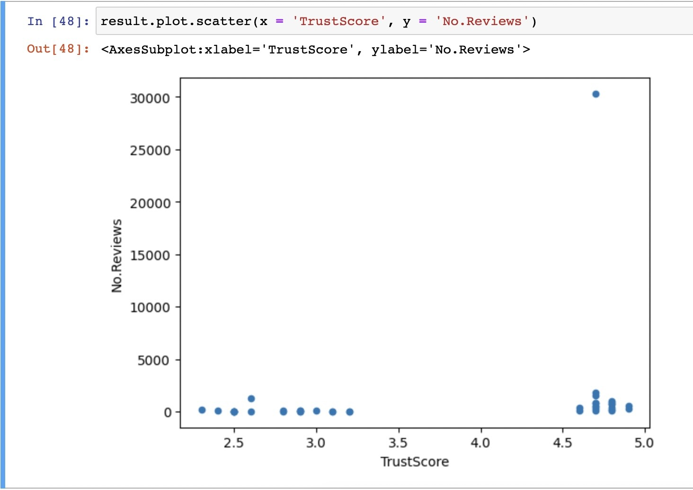
Companies Rating & Correlation between Trust Scores & Reviews
Insights
Companies with higher Trust Scores obtain more reviews
However, the relations are not in straight linear structure
Correlation score is 0.199

Slide 13
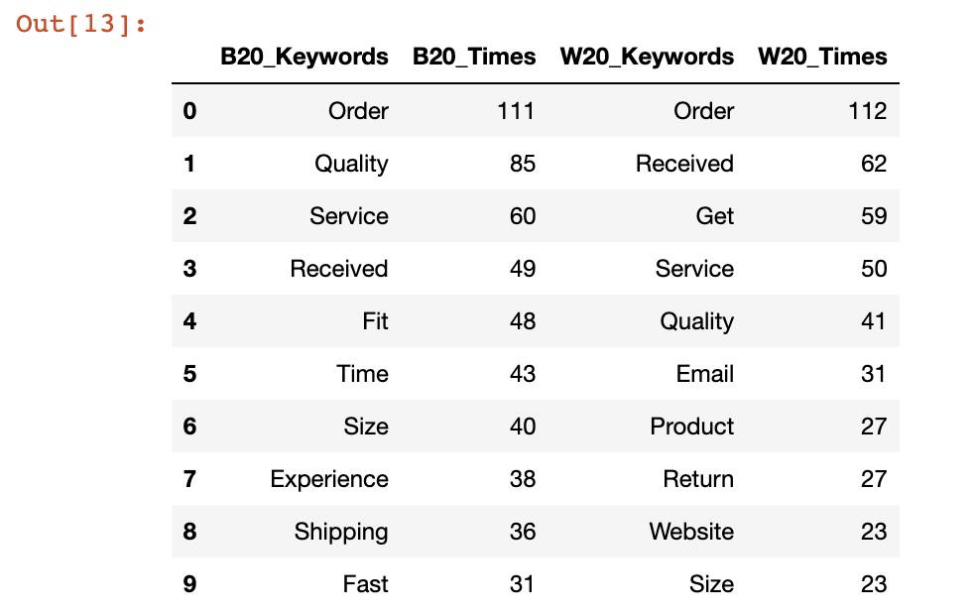
Analysis – Keyword analysis
From the output we classify keywords into 3 groups
Delivery
Product
Service
By comparing keywords from B20 & W20 retailers
There are numbers of intersection on the keywords i.e., order, quality, received

Slide 14
Keywords Analysis (2)
For Best 20 retailers
customer admires most for delivery, they expect timely and fast dispatch
for products, quality and fit sizing win customers’ compliments
service and experience also contribute to the good comments
For Worst 20 retailers
customer complains most for delayed and wrong delivery, return is also an issue from them
for products, it shares similar situation with the best 20 companies
lastly for service, email reply and website guidelines may affect customers’ shopping experience
In short
By tackling the issues on orders delivery, service and product quality, we can already cater what customers concern most on their spendings

Slide 15
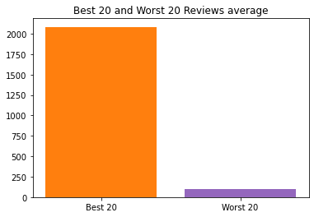
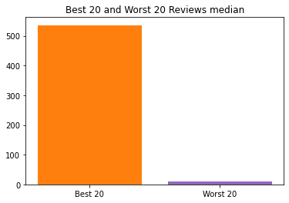
Analysis – Population data overview
There are 41708 reviews for the best 20 rated retailers in total and 1925 reviews for the worst 20 in total
For best 20 rated retailers, each retailer has 2085.4 reviews on average
While each worst rated retailers has 96.25 reviews on average
However, there are extreme outliers that have reviews more than 30000 reviews
Thus, the median of reviews number for the best 20 rated retailers is 536, 11 for the worst 20

Slide 16
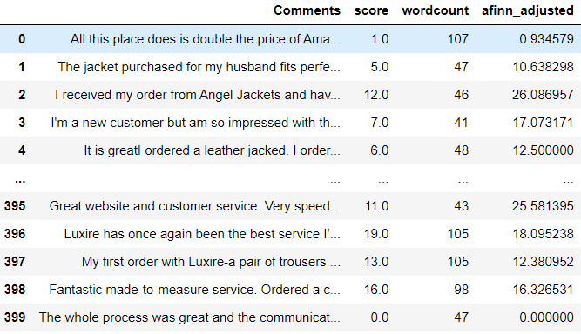
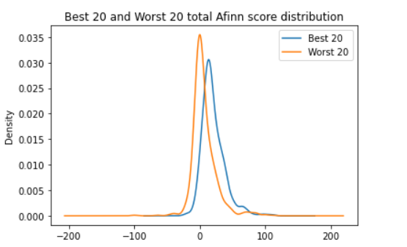
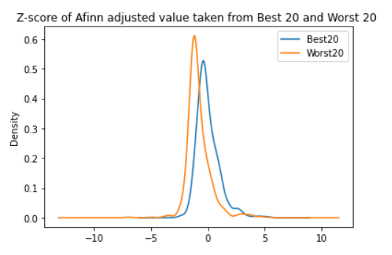
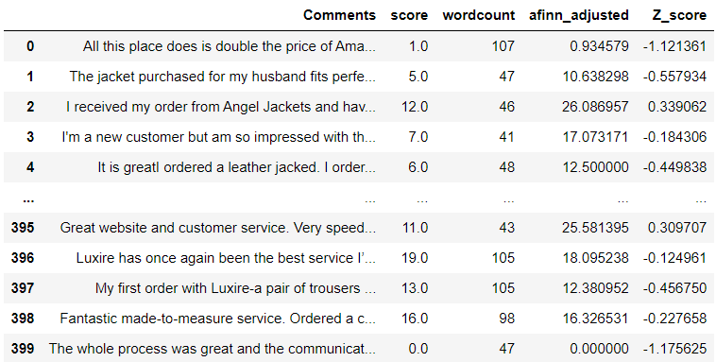
Analysis – Sentiment analysis
Through trivial sampling, we obtained 400 reviews from the best 20 retailers and 764 reviews from the worst 20 retailers, accounting for 43.2% and 7.8% in their section. Through checking the probability density, We assume they follow normal distribution:

Slide 17
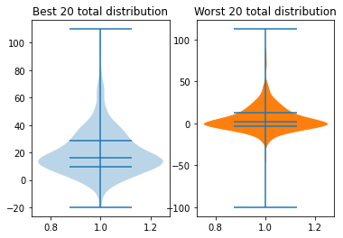
Analysis – Sentiment analysis
Best 20 retailers only have 16 negative comments while worst 20 retailers get 267 negative comments
The ratio of negative reviews to the whole data are 4% and 35% respectively
Variance of best 20 is 297, for the worst 20 is 338
From the following Afinn score distribution, the median of Best 20 retailers is about 17%, while that of the Worst 20 is about 3%. So, customers who bought clothes from Best 20 retailers who have higher Trust Scores are more satisfactory.

Slide 18
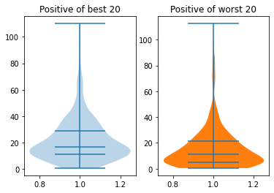
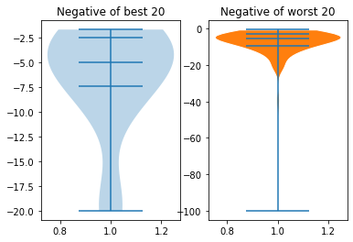
Analysis – Sentiment analysis
The positive reviews of the worst 20 retailers have more spread distribution, while the negative reviews are more centered, this shows the variation in reviews

Slide 19
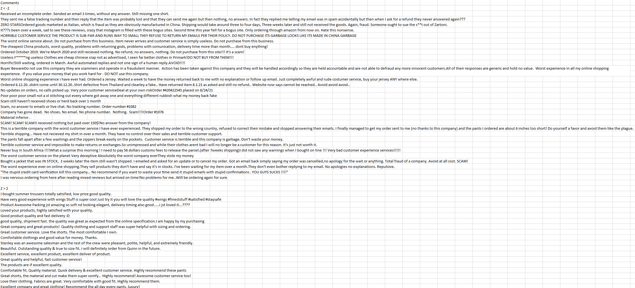
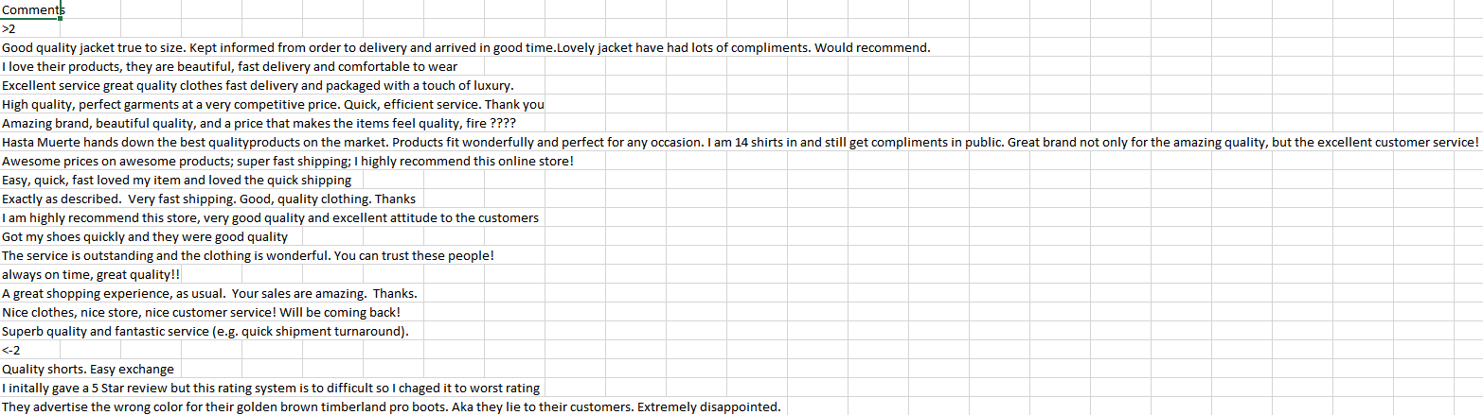
Analysis – Sampling
As we assume the sample data follows normal distribution, so we want to focus more on outliers
We extract outliers which have Z-score of adjusted Afinn score ± 2 S.D.

Slide 20
Conclusion
Limitations

Slide 21
Challenges and Limitations
Challenges
There are values that we have to scrape with different class names due to no content inside
Some worst-rated companies only have good reviews which makes it quite confusing
Existence of extreme outliers have much more reviews makes it hard to categorize
Unrevealed data (No trust score of every user shown on the website)
Limitations
There are too many reviews, we can only do random sampling for that (Time cost)
It takes a more advanced skillset to better interpret comments & reviews
i.e. there are negative comments that get positive Afinn score (Algorithm limitation)
Knowledge limitation on Inferential Statistics

Slide 22
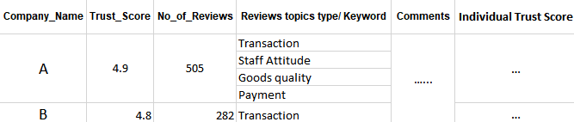
Conclusion
It is hard to scrap data from other websites, but if we have our own websites, we can get complete data so that only need to do a little data cleaning for the noises or incomplete data. This time the data follows the normal distribution, but what if next time it's not?
For big data sets, algorithm validity is of paramount importance which can greatly reduce the human resources needed and efficiently categorize data for analysis.
We hope can do better after learning data mining, deep learning and machine learning.

Slide 23
Conclusion
Considering the analyses we did, we have below insights:
The higher trust scores & reviews a company obtains , the more satisfied customers are
Best 20 companies seldom get negative feedback from customers while there are higher portion of negative feedback on worst 20 companies
Orders delivery, service and product quality are the top 3 concerns from the customers, if we can make sure of these, we get happy and satisfied customer

Slide 24
Q&A

Slide 25
End

